Slide 1
Universal Verification Methodology
Simple testbench integration

Slide 2
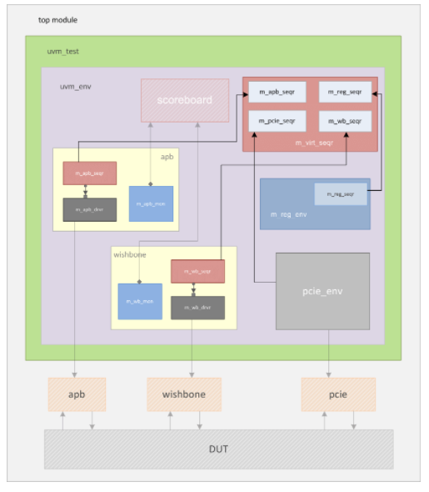
UVM Virtual Sequencer
Notes:
The UVM Sequencer contains handles to other sequencers.
Why do we need this?
Because we plan to use virtual sequences and want to have control over all sequencers from a central place.
A request type is not required here because this sequencer is generic and not limited to handle only one particular data type.
In this example, the environment has an APB agent, Wishbone agent, PCIE environment and a regular register layer environment. Each of these components have their own sequencers on which they are launched. A virtual sequencer called m_virt_seqr is instantiated to hold references to each individual sequencer. Hence, a virtual sequence executing on this virtual sequencer will have access to all the sequencers in the testbench.

Slide 3
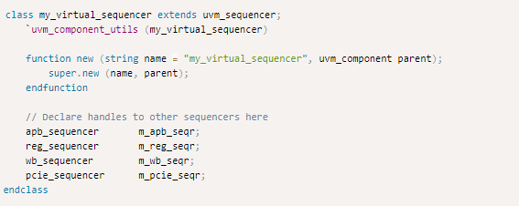
Example
Notes:
Unlike normal sequencers, the virtual sequencer is not user-parameterized to a transaction type since this sequencer can execute multiple transaction types.

Slide 4
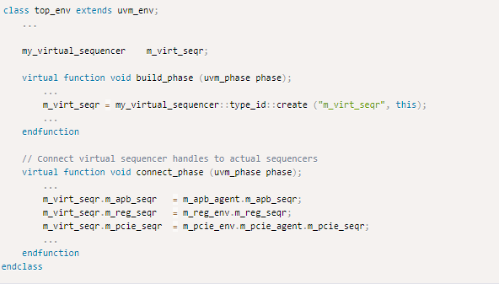
Notes:
In the top environment, an instance of the virtual sequencer is created and real sequencers are connected with their respective handles in the virtual sequencer.
Also, a virtual sequencer operates best when used with a virtual sequence.

Slide 5
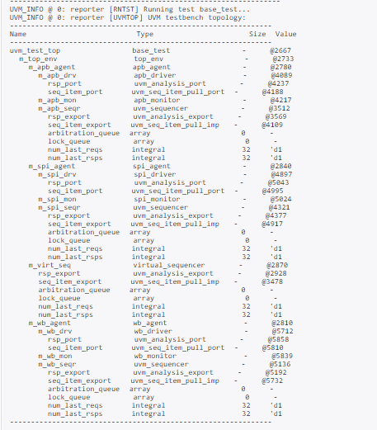
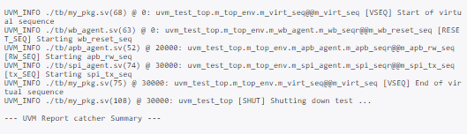

Slide 6
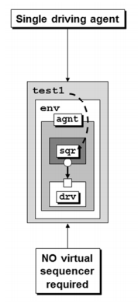
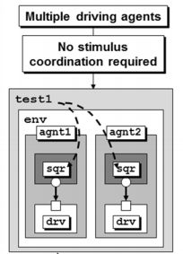
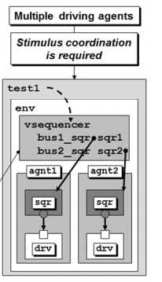

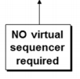

When do we need a virtual sequencer?
Notes:
If you have only one driving agent, you do not need a virtual sequencer.
If you have multiple driving agents, but no stimulus coordination is required, you do not need a virtual sequencer.
If you have multiple driving agents, and stimulus coordination IS required, you need a virtual sequencer.
On the other hand, let’s consider a testbench with multiple agents but no coordination of stimulus, this testbench is required to be extended in the future for coordinated stimulus, then the environment will require updates to include one or more virtual sequencers. These updates, that are performed later in the project could be quite painful, as compared to building in a virtual sequencer from the beginning and taking advantage of the virtual sequencer when needed. Which is why, it is recommended to add a virtual sequencer in most of the UVM testbenches when developing initially.

Slide 7
Why “virtual” sequencer/sequence
Unlike SV virtual classes, virtual methods, and virtual interfaces, “virtual” keyword not required for virtual sequencers or virtual sequences.
There is no uvm_virtual_sequencer or uvm_virtual_sequence base class.
Notes:
..All sequencers and virtual sequencers are derived from uvm_sequencer class and all sequences and virtual sequences are derived from uvm_sequence class.

Slide 8
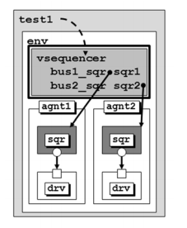
So, why “virtual”?
3 attributes of a virtual sequencer:-
Controls other sequencers
Not attached to a driver
Does not process items itself
Notes:
A virtual sequencer is not connected to a driver. Instead of executing individual sequence items or a driver via a sequencer port, it executes sub-sequences and sequence-items on sequencers via handles to sub-sequencer targets.
The virtual sequencer is “virtual” because typically, sequences are not really run on this sequencer, the sequences are being run on the subsequencers via handles defined in the virtual sequencer.
A virtual sequencer can run multiple transaction types on multiple real sequencers. The virtual sequence is typically just coordinating execution of other sequences on the appropriate subsequencers.

Slide 9
Three virtual sequencer modes
3 ways in which virtual sequencers interact with sub-sequencers:-
“Business as usual” – Virtual sequencers and sub-sequencers send transactions simultaneously
Disable sub-sequencers – Only virtual sequencer is driving
Using grab() and ungrab() – Virtual sequencer takes control of the underlying driver(s) for a limited time
Notes:
To invoke sequences do one of the following,
a) use `uvm_do method appropriately.
b) Use the sequence start() method.

Slide 10
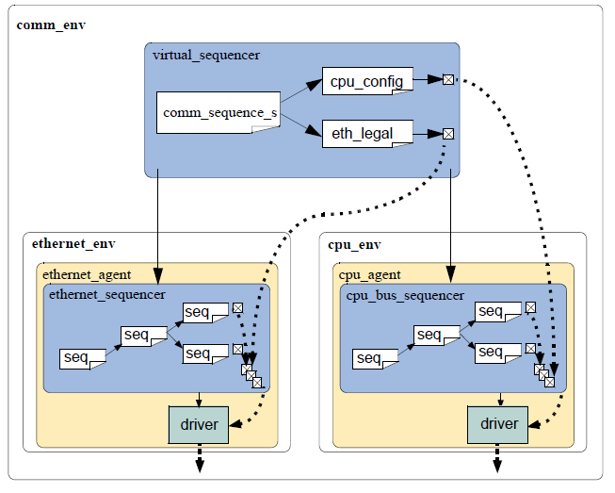
Notes:
This shows business as usual as well as disabling of sub-sequencers with the virtual sequencer alone driving.

Slide 11
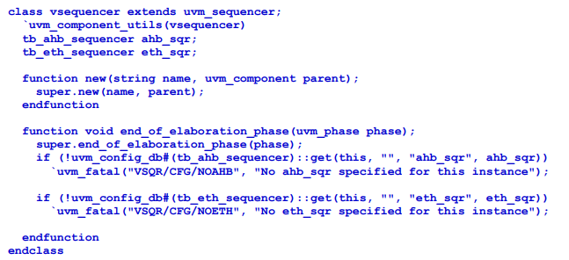
Example
Notes:
The virtual sequencer declares sub-sequencer handles. These sub-sequencer handles will be assigned from values specified in the configuration database during the end_of_elaboration_phase()
Unlike Transaction Level Model (TLM) connections that are used to connect most components in a UVM testbench, the subsequencer handles are not set using a TLM connect() method, but are specified by the environment using the configuration database. It is then the job of the virtual sequencer to extract those handles from the configuration database and assign them to the two handles declared in the virtual sequencer. The actual subsequencers will be created in the build_phase(). Therefore, their handles will only be available to be put in the configuration database by the environment in its connect_phase(). Thus, the virtual sequencer will have to retrieve them in the next phase: end_of_elaboration_phase().
It can be seen from this example, that the vsequencer is just a container for the handles to subsequencers and other configuration parameters. The virtual sequences assume the virtual sequencer has been properly configured before the virtual sequences execute in the run_phase(). They can then access these configuration parameters in the virtual sequencer via their p_sequencer handle.

Slide 12
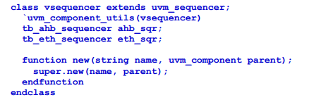
Simplified Example
Notes:
In this simplified example, the subsequencer handles are still declared but instead of the virtual sequencer retrieving the handles from the uvm_config_db, it will be the job of the environment to copy the subsequencer handles from the instantiated agents to the handles declared in this vsequencer.
The previous example has the advantage that it extracts its subsequencer handles that would be stored in the uvm_config_db, which might then make that vsequencer easier to reuse in different hierarchies, while this simplified example’s vsequencer is indeed simpler and it is not difficult for the environment to copy the subsequencer handles directly into the simple vsequencer

Slide 13
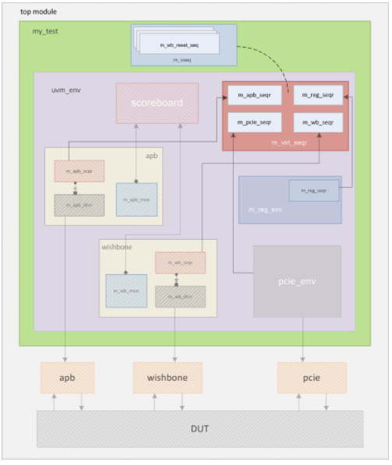
Virtual Sequences
A container to start
multiple sequences on
different sequencers in
the environment.
Notes:
The virtual sequence is usually executed by a virtual sequencer that has handles to real sequencers. The need for a virtual sequence arises when you require different sequences to be run on different environments. For example, an SoC design might have multiple different interfaces that might need to be driven by a different set of sequences on individual sequencers. So, the best way to start and control these different sequences is from a virtual sequence. It becomes virtual because it is not associated with any particular data type.

Slide 14
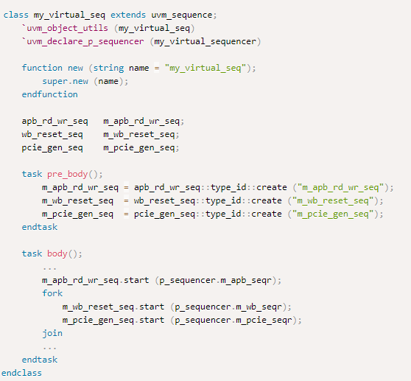
Notes:
my_virtual_seq is derived from uvm_sequence just like any other sequence
A handle called p_sequencer is created within the sequence via macro `uvm_declare_p_sequencer and assigned to be run with my_virtual_sequencer
Each sequence is started on its corresponding sequencer using the start() method
Each sequencer is referenced by p_sequencer handle which points to the virtual sequencer

Slide 15
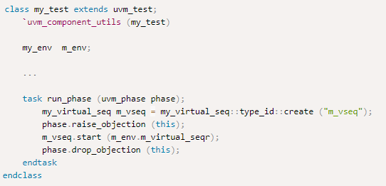
Notes:
Once a virtual sequence is defined, you can start this in the test.

Slide 16
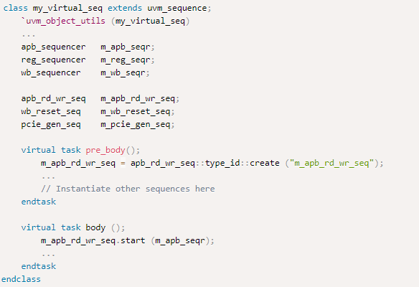
Notes:
You can also put handles to individual sequencers within the virtual sequence, and then would not need a virtual sequencer.

Slide 17
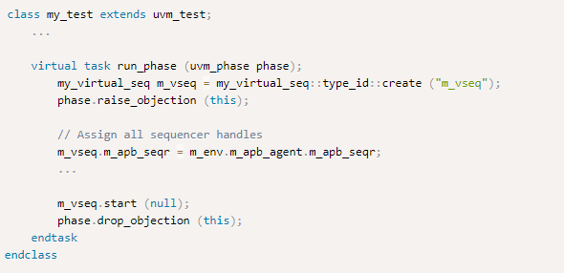
Notes:
The handles to sequencers within the sequence needs to be assigned prior to starting the virtual sequence.
The creation and assignment of sequence can also be split into build_phase and connect_phase within my_test.

Slide 18
2 methods to execute sequences
`uvm_do - easiest to use, but less simulation efficient
randomize() with start()
Notes:
The `uvm_do macros may be the easiest to use, but may also be less simulation efficient(because the sub-sequences are always allocated and randomized before being executed) and more difficult to understand if the user ever expands the `uvm_do macro code.
Use explicit allocation, and direct assignments or calls to randomize() before using the start() method to execute the sequences on the chosen subsequencer that requires more coding effort, but is straightforward and allows the creation of and execution of more directed sequences.

Slide 19
Checking for DUT correctness
Assertions – Derived from the specification or from the implementation and ensure correct timing behavior. Assertions typically focus on signal-level activity.
Data-checkers – Ensure overall device correctness.
Notes:
Getting the device into desired states is a significant part of verification. The environment should verify valid responses from the DUT before a feature is declared verified. Two types of auto-checking mechanisms can be used: Assertions & Data checkers.
Checking and coverage should be done in the passive domain independently of the active logic. Reusable assertions are a part of reusable components.

Slide 20
Implementing a coverage model
Selecting a coverage method
Implementing a Functional Coverage Model
Enabling and Disabling Coverage

Slide 21
Selecting a Coverage Model
Explicit Coverage
User-defined coverage
User specifies coverage goals, needed values, and collection time
Eg: Functional coverage
Disadvantage: missing goals are not taken into account
Notes:
No single coverage metric ensures completeness. There are two coverage methods:
Explicit coverage – Analyzing the coverage goals is straight-forward. Completing all the coverage goals must be one of the metrics used to determine the completion of DUT’s verification. Eg: SV Functional coverage. The disadvantage of such metrics is that missing goals are not taken into account.
Implicit coverage

Slide 22
Selecting a Coverage Model
Implicit Coverage
Done with automatic metrics that are driven from RTL or other metrics already existing in code
Eg: code coverage, expression coverage, FSM coverage
Disadvantage: difficult to map the coverage requirements to the verification goals
Notes:
Typically, creating an implicit coverage report is straightforward and doesn’t require a lot of effort. Eg: code coverage, expression coverage, FSM coverage.
In addition the disadvantage stated, it is also difficult to map coverage holes into unexecuted high-level features, and implicit coverage is not complete, since it doesn’t take into account high-level abstract events and doesn’t create associations between parallel threads (2 or more simultaneously occurring events).
Starting with explicit coverage is recommended. The coverage model should be built to represent high-level verification goals. Later, implicit coverage can be used as a ‘safety net’ to check and balance the explicit coverage.
NOTE- Reaching 100% functional coverage with very low code-coverage means that the functional coverage needs to be refined and enhanced.

Slide 23
Implementing a Functional Coverage Model
Protocol-specific functional coverage model
Disable some coverage unimportant aspects or don’t need to be verified
Extend the functional-coverage model and create associations between verification component coverage and other system attributes
Notes:
A verification component should come with a protocol-specific functional-coverage model.
You may want to disable some coverage aspects that aren’t important or dont need to be verified. For eg: you might not need to test all types of bus transactions in your system or you might want to remove that goal from the coverage logic that specifies all types of transactions as goals.
You might also want to extend the functional-coverage model and create associations between the verification component coverage and other attributes in the system or other interface verification components. For example, you might want to ensure
proper behavior when all types of transactions are sent and the FIFO in the system is full. This would translate into crossing the transaction type with the FIFO-status variable.

Slide 24
Enabling and Disabling Coverage
To disable coverage before the environment is created, use uvm_config_db interface.
Once the environment is created, the property can be set directly.

